Slide 1



Application of Maxwell Equation in Wireless power transfer technology
Transfer power wirelessly between coils
By:Ashis

Slide 2


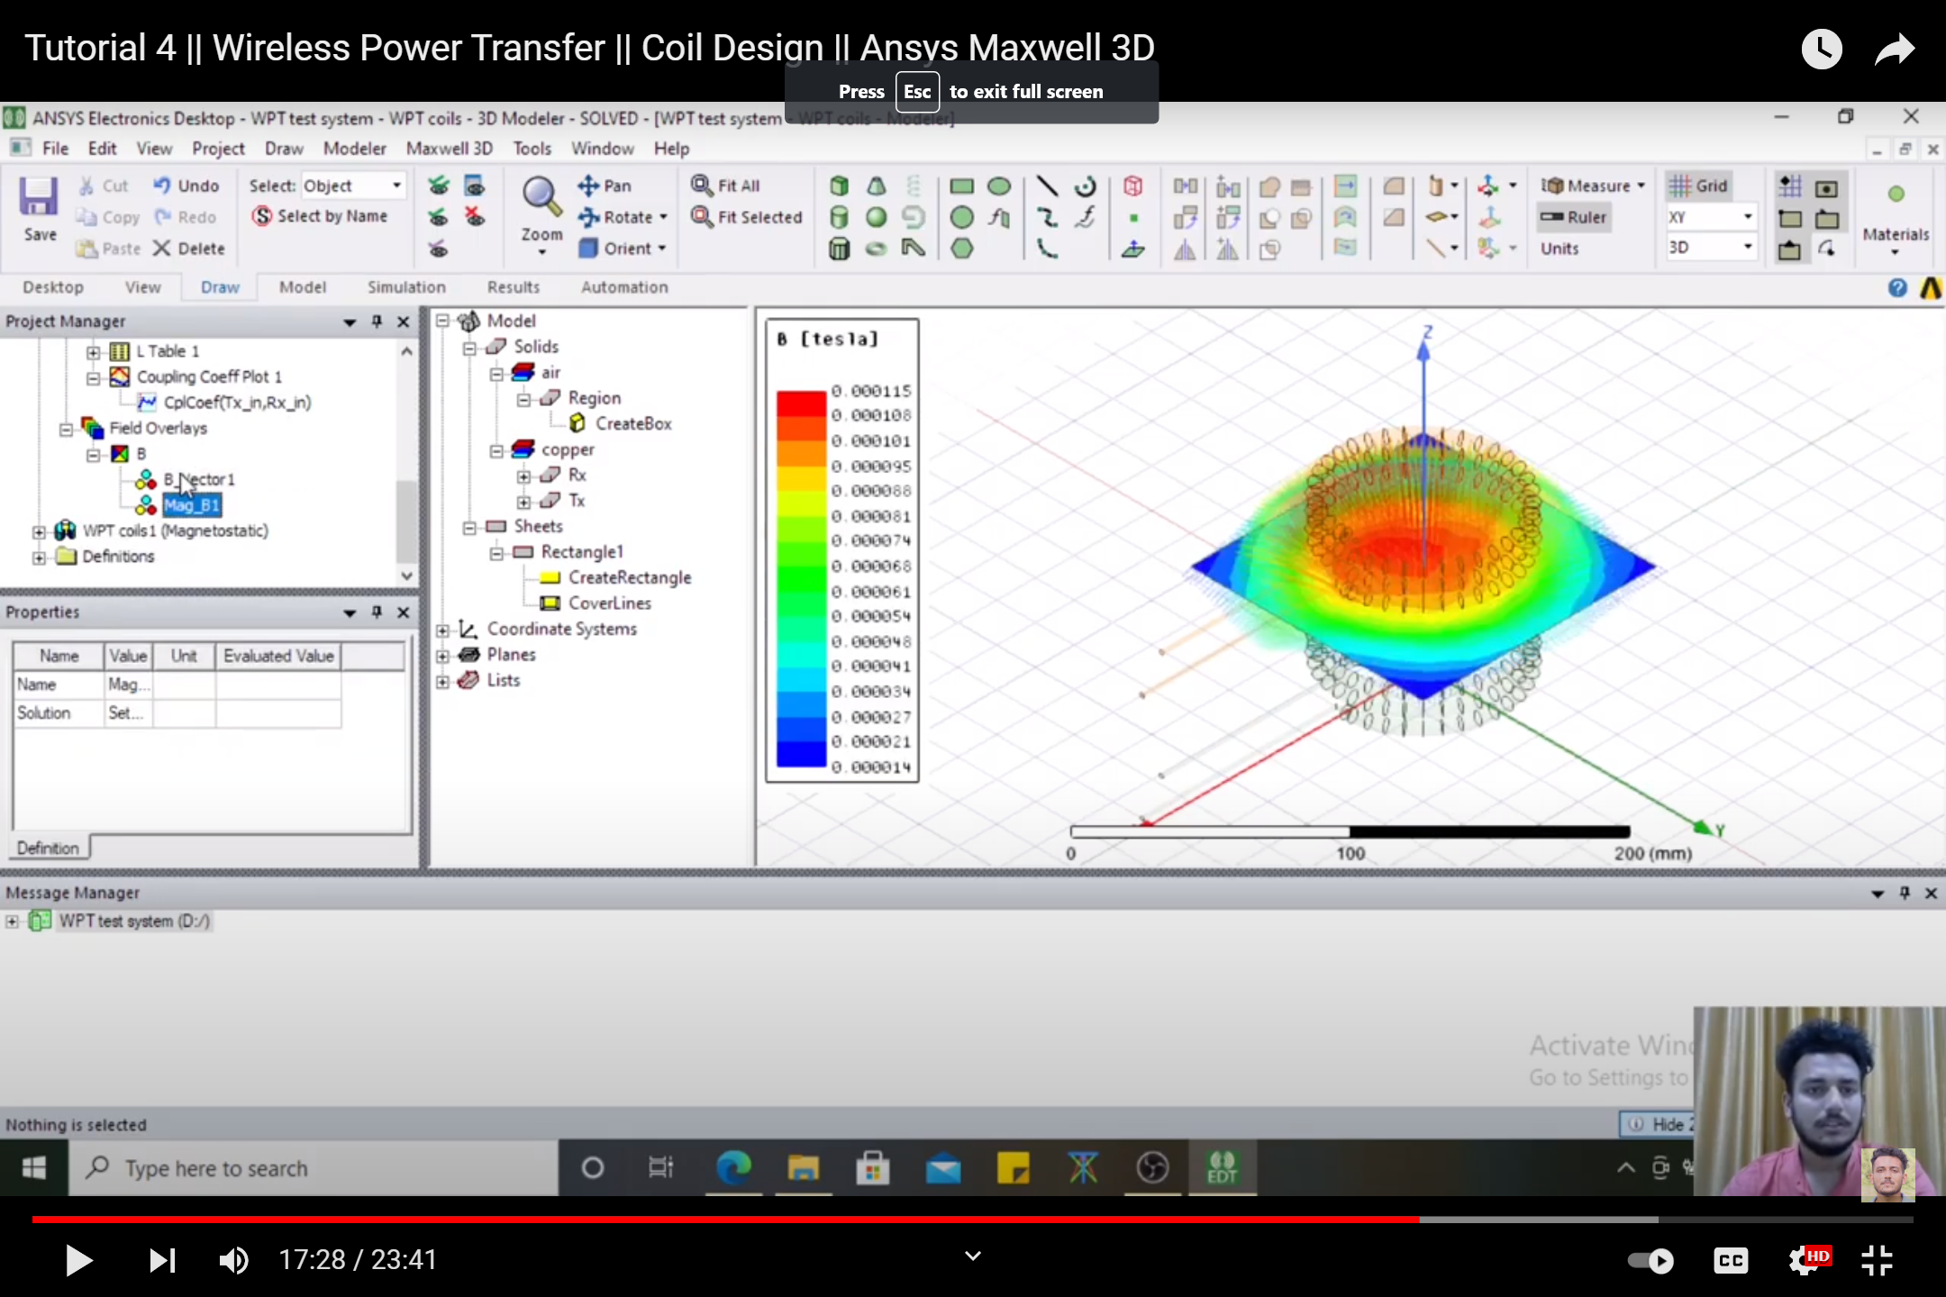
Inductive coupling simulation
power is transferred over short distances by magnetic fields using inductive coupling between coils of wire

Slide 3
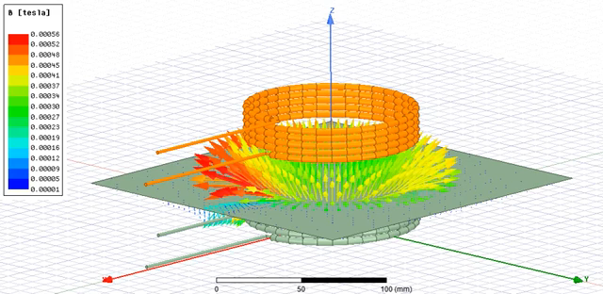
Animation of changing magnetic field density vector around two coils

Slide 4
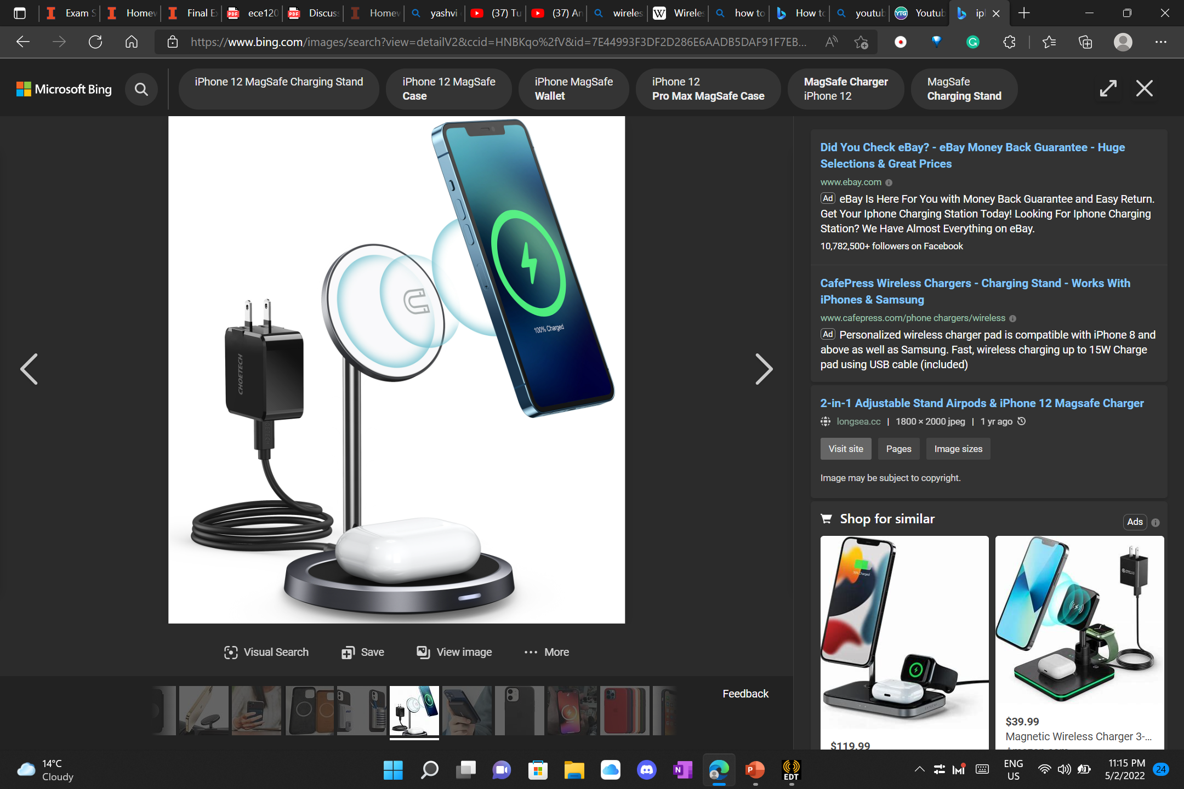
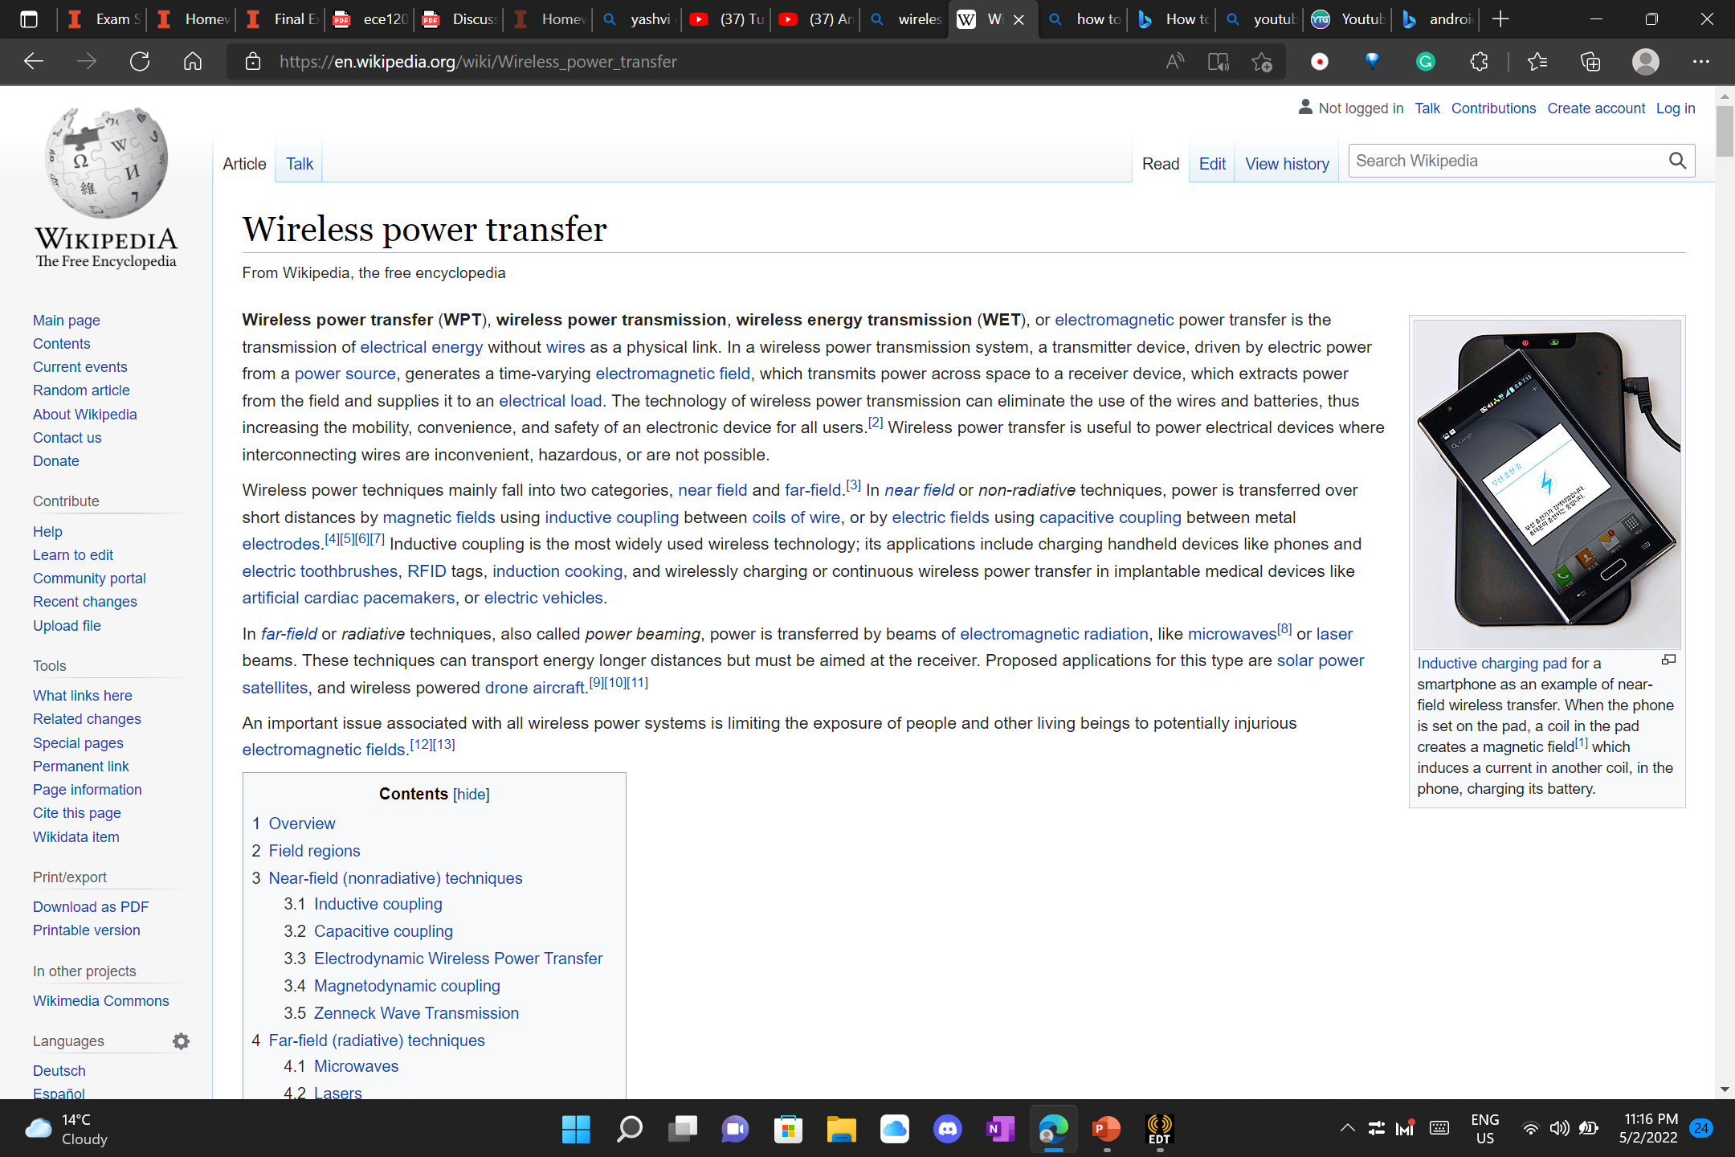
Use of wireless power transfer technology
Wireless power transfer is used widely, and the common examples are iPhone magsafe chargers or the smartphone chargers.

Slide 5
Working Principle and how EM plays a role
Wireless power transfer is backed by the fundamentals of electromagnetic field and maxwell equations.
a transmitter device, driven by electric power from a power source, generates a time-varying electromagnetic field, which transmits power across space to a receiver device, which extracts power from the field and supplies it to an electrical load.
the type of electromagnetic energy they use: time varying electric fields, magnetic fields, radio waves, microwaves, infrared or visible light waves.

Slide 6
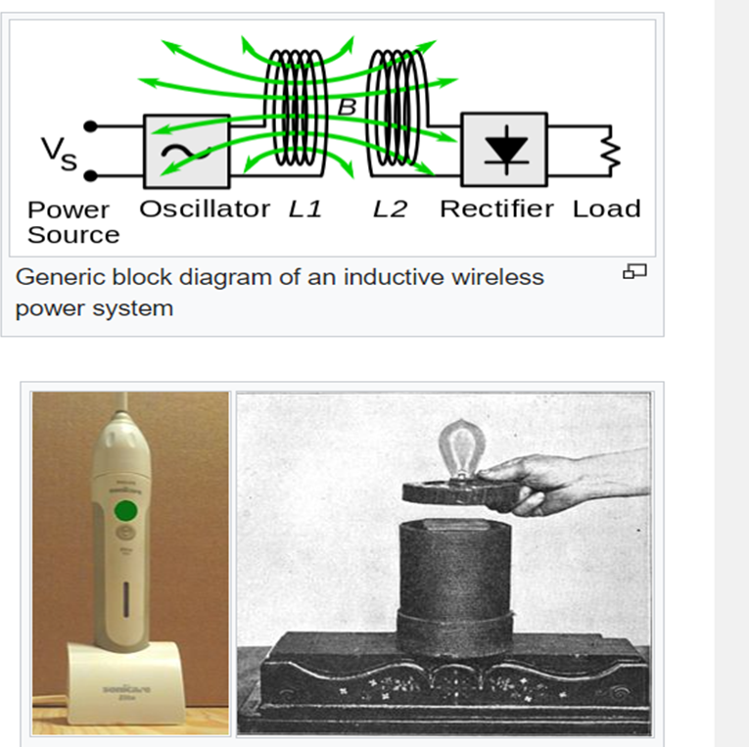
Working principle (in detail)
In inductive coupling (electromagnetic induction or inductive power transfer), power is transferred between coils of wire by a magnetic field. The transmitter and receiver coils together form a transformer (see diagram next slide). An alternating current (AC) through the transmitter coil (L1) creates an oscillating magnetic field (B) by Ampere's law. The magnetic field passes through the receiving coil (L2), where it induces an alternating EMF (voltage) by Faraday's law of induction, which creates an alternating current in the receiver. The induced alternating current may either drive the load directly, or be rectified to direct current (DC) by a rectifier in the receiver, which drives the load.

Slide 7
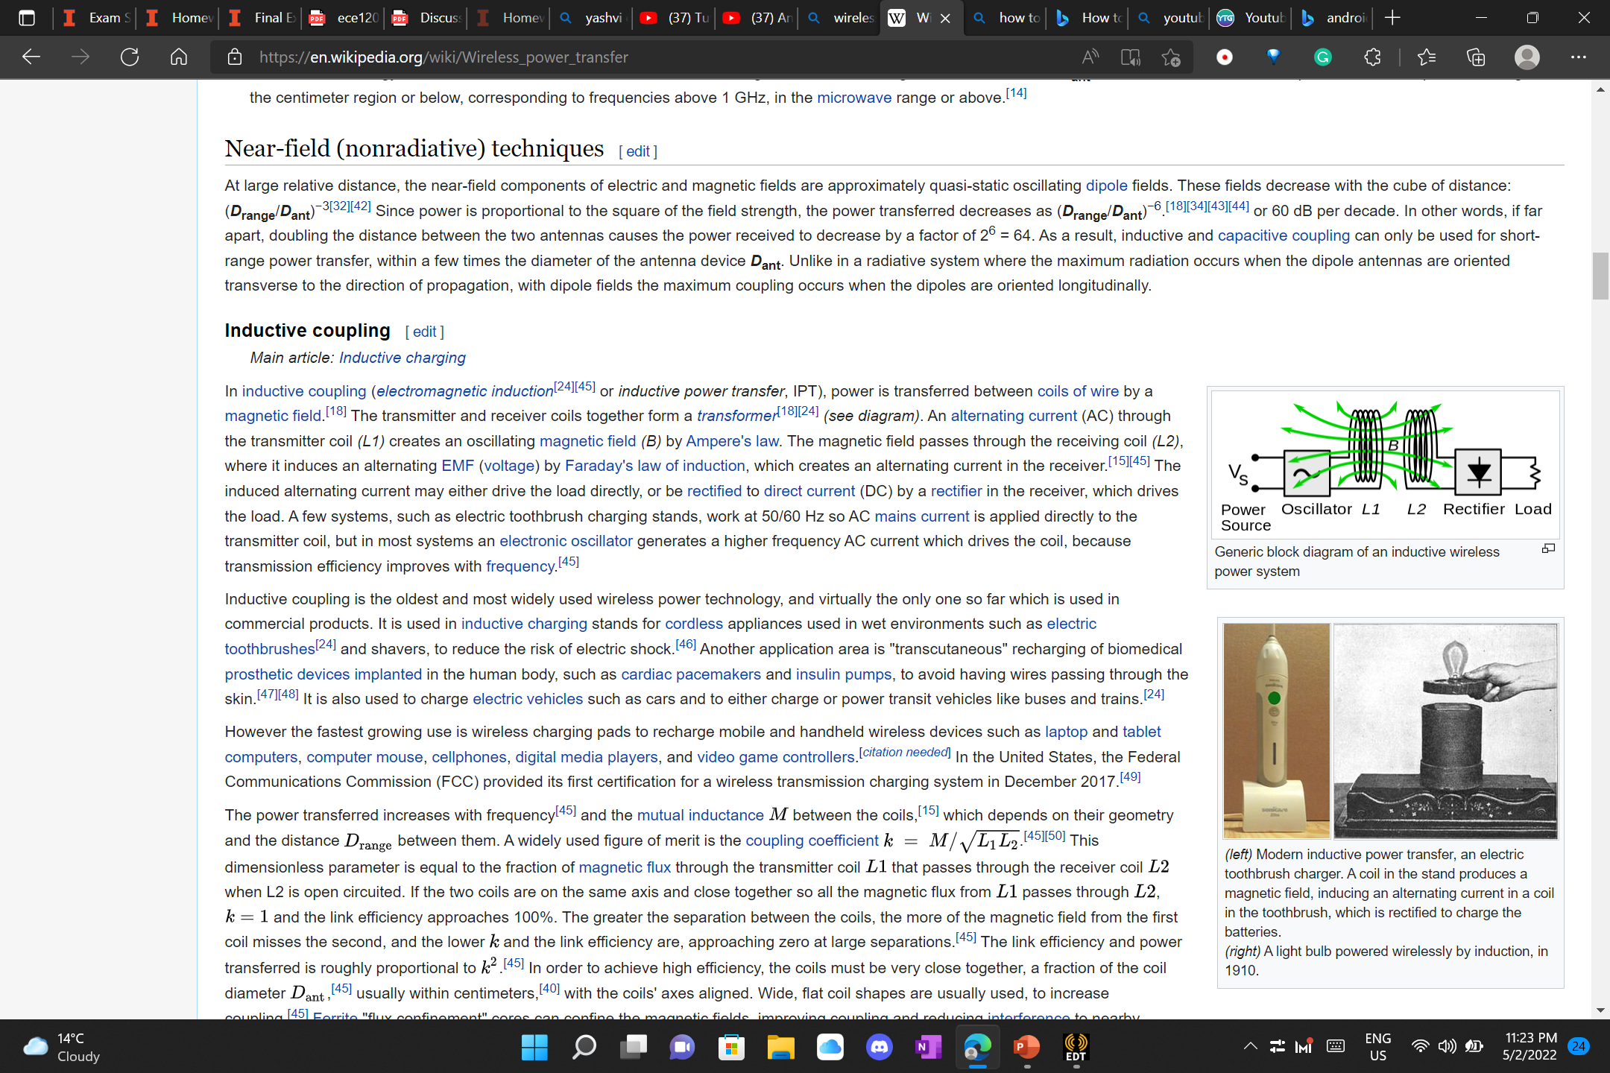
Block diagram of an inductive wireless power system

Slide 8
What is inductive coupling? (role of Maxwell Equation)
In electrical engineering, two conductors are said to be inductively coupled or magnetically coupled when they are configured such that a change in current through one wire induces a voltage across the ends of the other wire through electromagnetic induction. A changing current through the first wire creates a changing magnetic field around it by Ampere's circuital law. The changing magnetic field induces an electromotive force (EMF or voltage) in the second wire by Faraday's law of induction. The amount of inductive coupling between two conductors is measured by their mutual inductance.

Slide 9
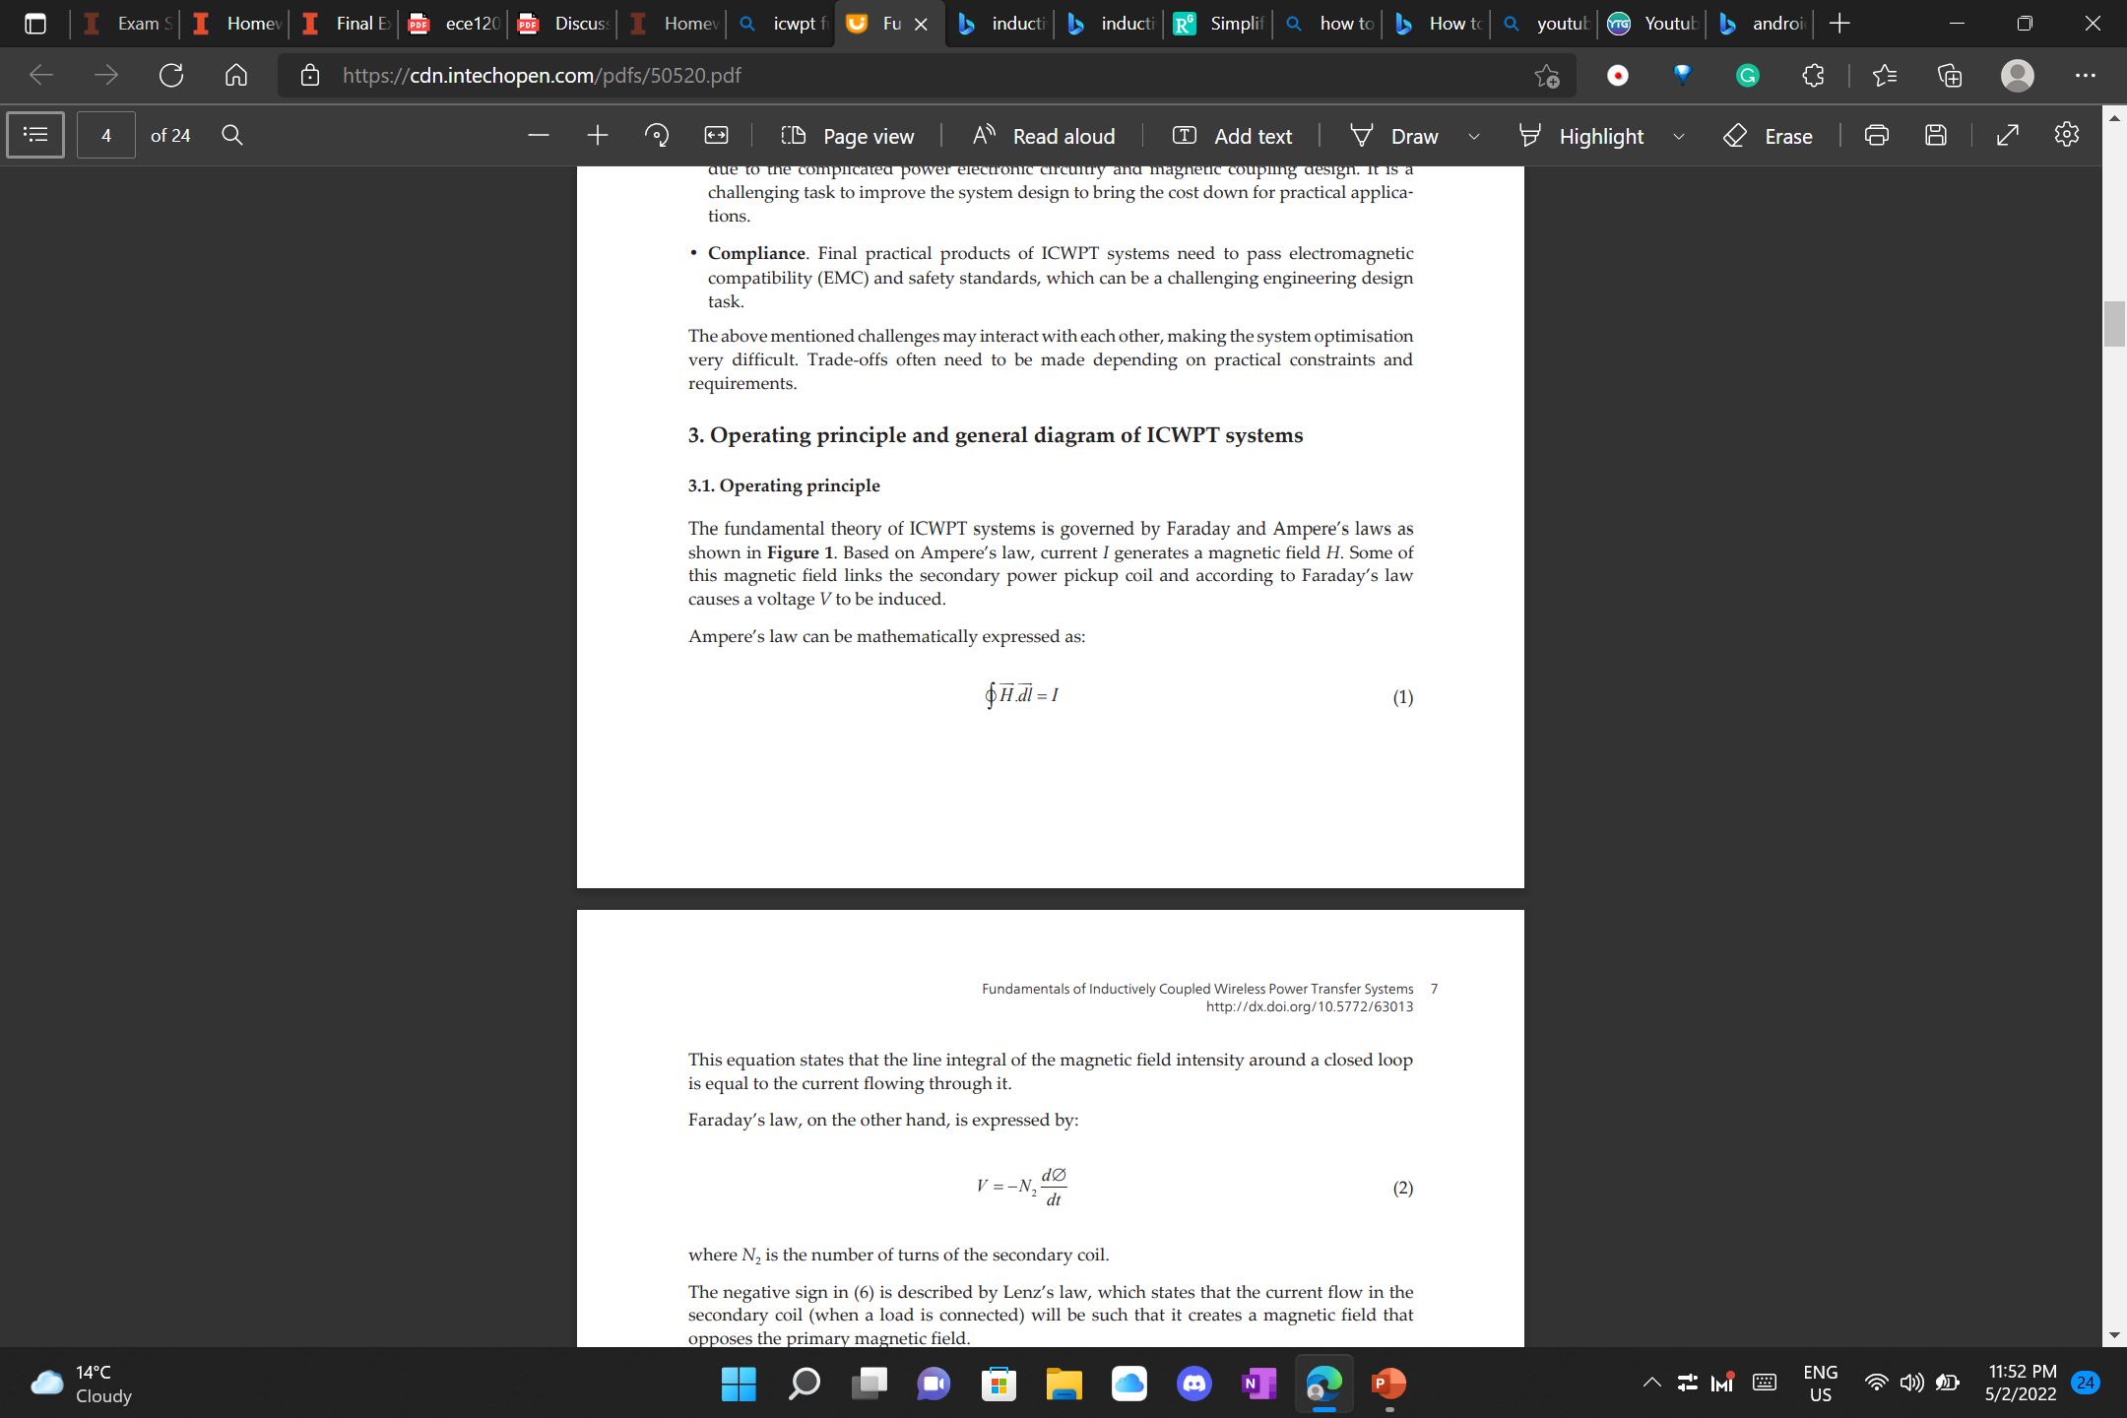

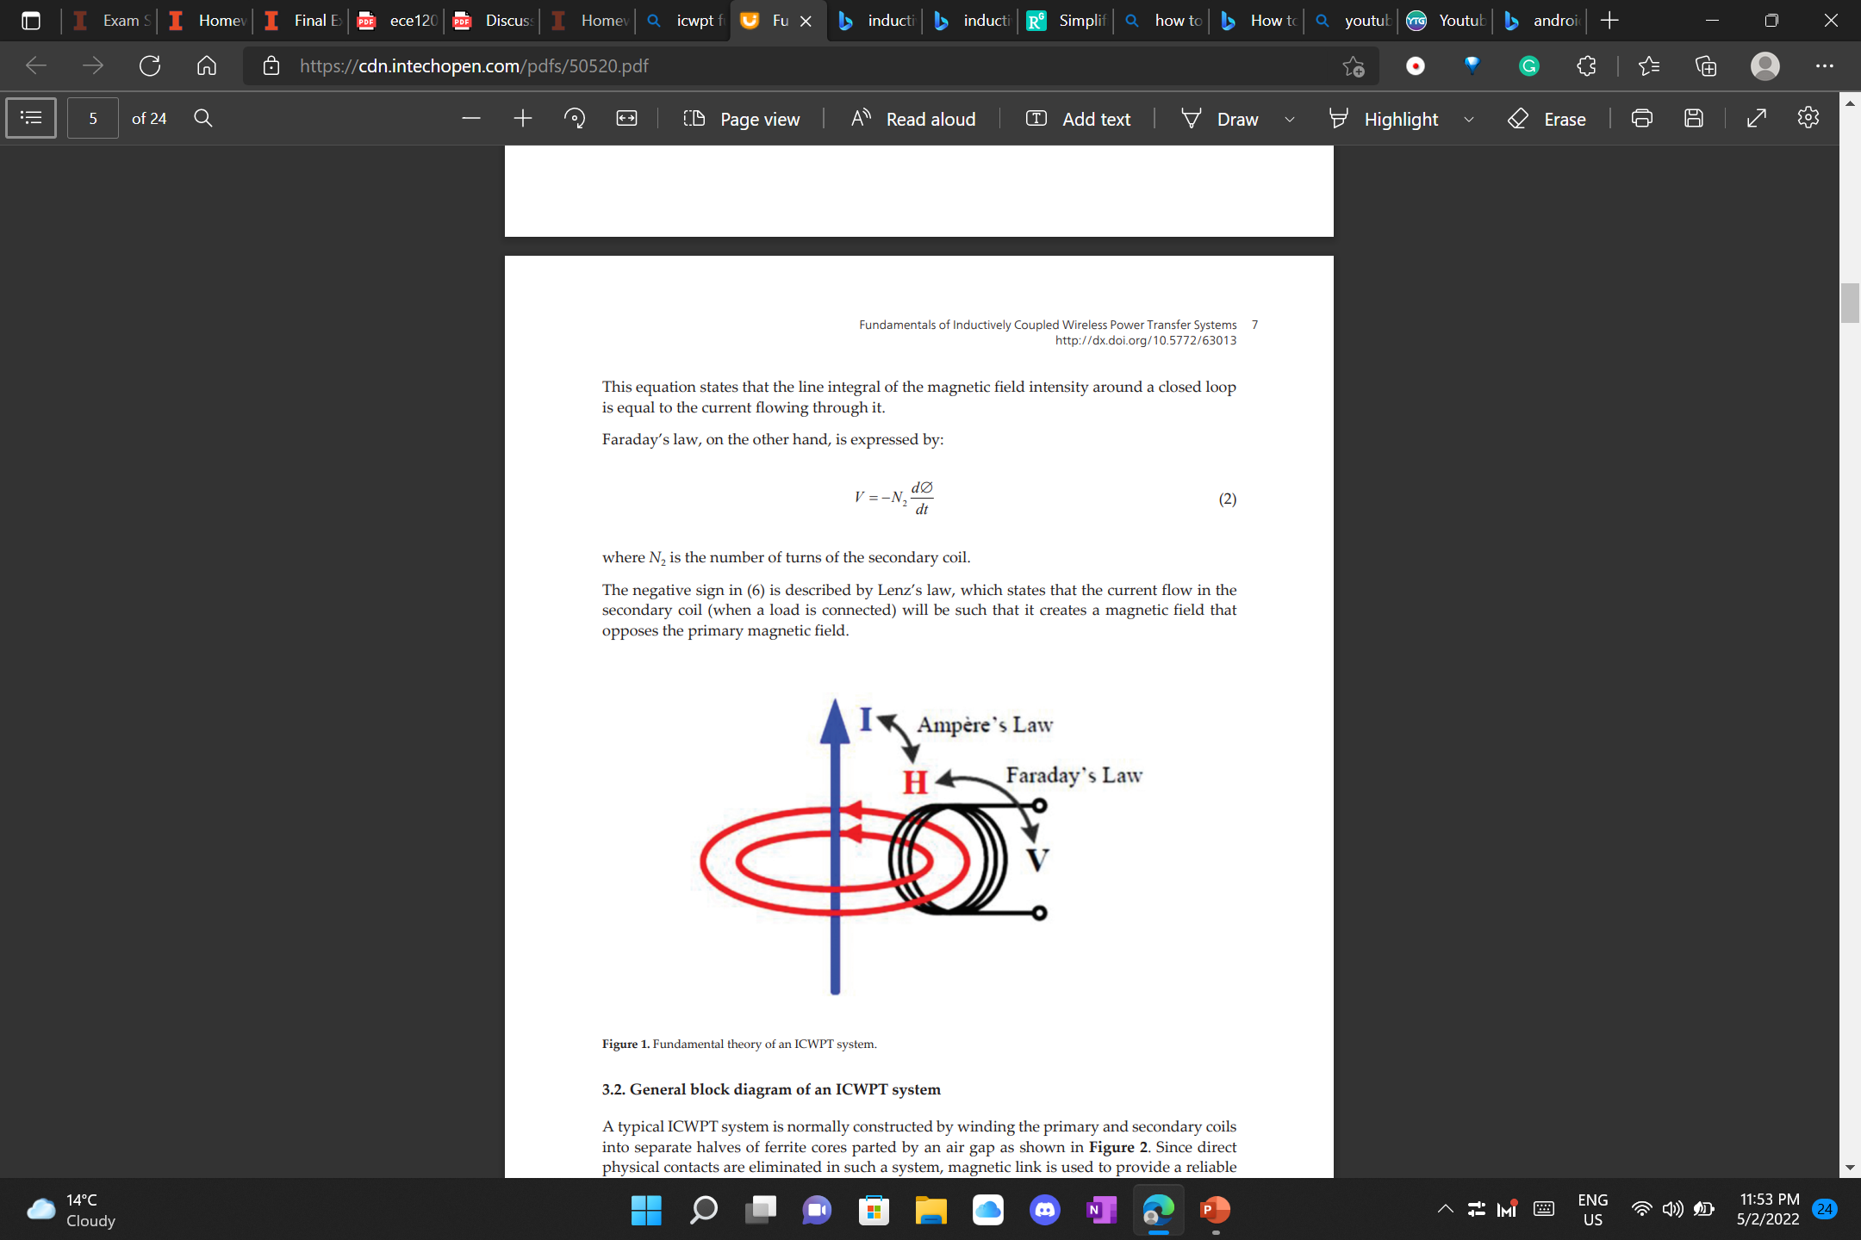
Introducing two useful maxwell equation
Inductively coupled wireless power transfer is governed by Amperes law and Faradays law.
In shrt: Current induces magnetic field and voltage is produced

Slide 10
THANKYOU

